Slide 1
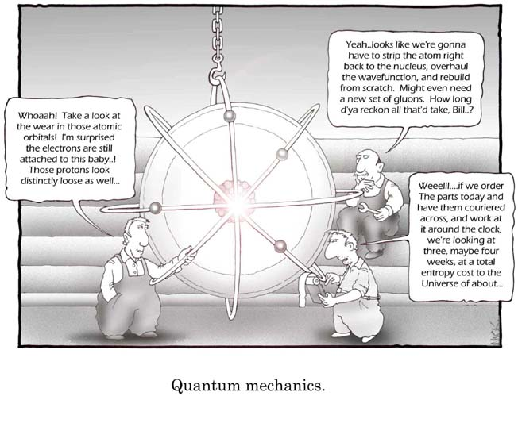
Electron Orbitals
Cartoon courtesy of lab-initio.com

Slide 2
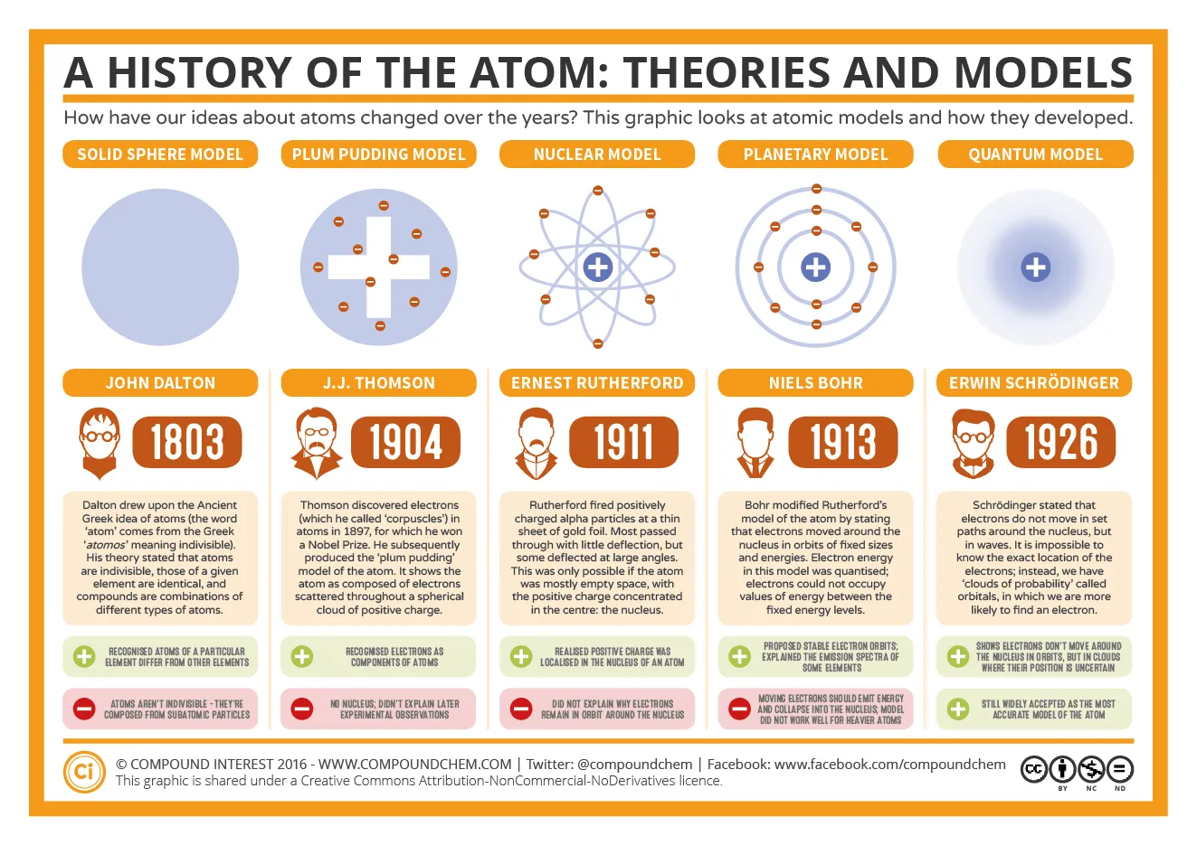

Slide 3


Slide 4
Electron Levels
Electrons exist within a cloud surrounding the atomic nucleus
The cloud consists of different energy levels, called orbitals
A few factors governing electron behavior:
The negative charge of electrons are attracted to the positive charge of the protons in the nucleus
The negative charge of electrons is repulsed by the negative charge of other electrons
Electrons are most stable when at the lowest energy state possible

Slide 5

The Bohr Model of the Atom
I pictured electrons orbiting the nucleus much like planets orbiting the sun.
But I was wrong! They’re more like bees around a hive.
Neils Bohr
Bohr’s model worked well for the Hydrogen atom only

Slide 6
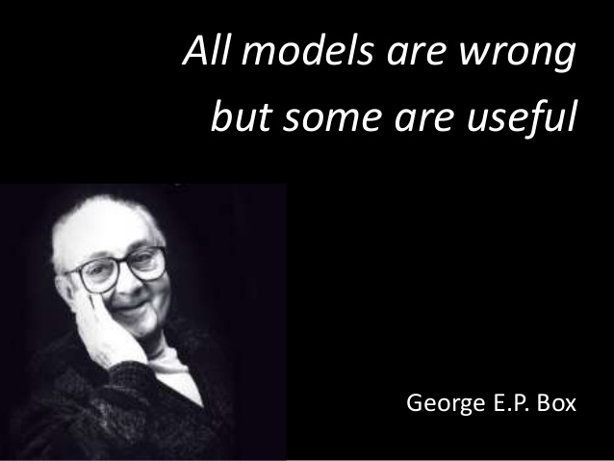

Slide 7
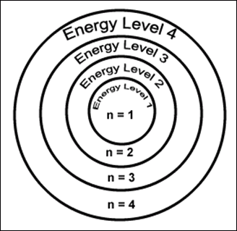
Electron Energy Level (Shell)
Generally symbolized by n, it denotes the probable distance of the electron from the nucleus. “n” is also known as the Principal Quantum number
Number of electrons that can fit in a shell:
2n²

Slide 8
Electrons per Shell 2n²
Level 1: 2(1)² = 2
Level 2: 2(2)² = 8
Level 3: 2(3)² = 18
Level 4: 2(4)² = 32
This really only works for the first 4 levels

Slide 9
Shells, Sub-Shells, and Orbitals
A ‘shell’ describes the energy level that an electron occupies
An ‘orbital’ describes the shape or location of an electron in the space around the nucleus
A shell contains sub-shells
Sub-shells can be s, p, d, or f
Sub-shells contain orbitals
an s sub-shell has 1 orbital, p has 3 orbitals, d has 5 orbitals, f has 7 orbitals
An orbital can hold a maximum of 2 electrons

Slide 10
Electron Orbitals
An orbital is a region within an energy level where there is a probability of finding an electron.
Orbital shapes are defined as the surface that contains 90% of the total electron probability.

Slide 11
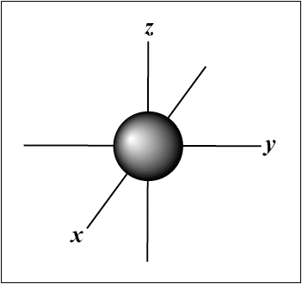
Shape of the orbital in an s sub-shell
The s orbital has a spherical shape centered around the origin of the three axes in space.

Slide 12
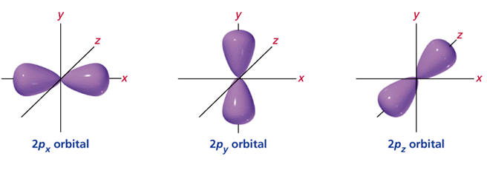
Shape of orbitals in a
p sub-shell
There are three dumbbell-shaped p orbitals in each energy level above n = 1, each assigned to its own axis (x, y and z) in space.

Slide 13
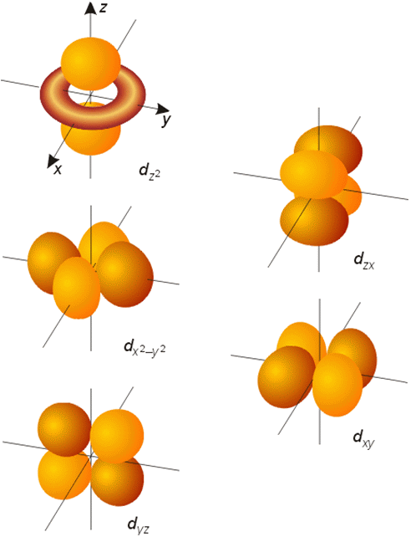
Orbitals in the d sub-shell
Things get a bit more complicated with the five d orbitals that are found in the d sublevels beginning with n = 3.
To remember the shapes, think of “double dumbbells” . . .
...and a “dumbbell with a donut”!

Slide 14
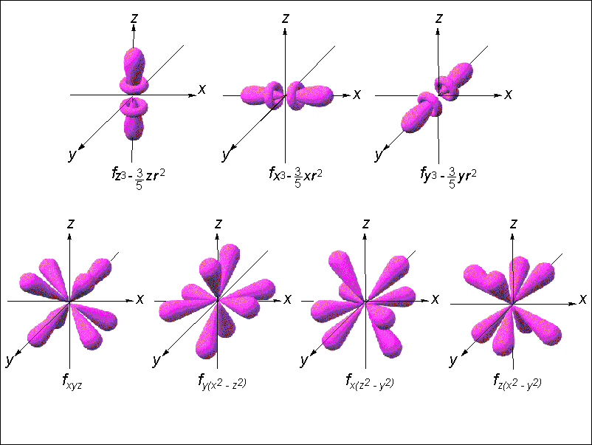
Orbitals in the f sub-shell

Slide 15
Energy Levels, Orbitals, Electrons
Energy Level (n) | Sub-shells found in energy level | Number of orbitals by sub-shell | Maximum Number of Electrons | Max Number of electrons per Energy level (2n²)
1 | s | 1 | 2 | 2
2 | s p | 1 3 | 2 6 | 8
3 | s p d | 1 3 5 | 2 6 10 | 18
4 | s p d f | 1 3 5 7 | 2 6 10 14 | 32

Slide 16
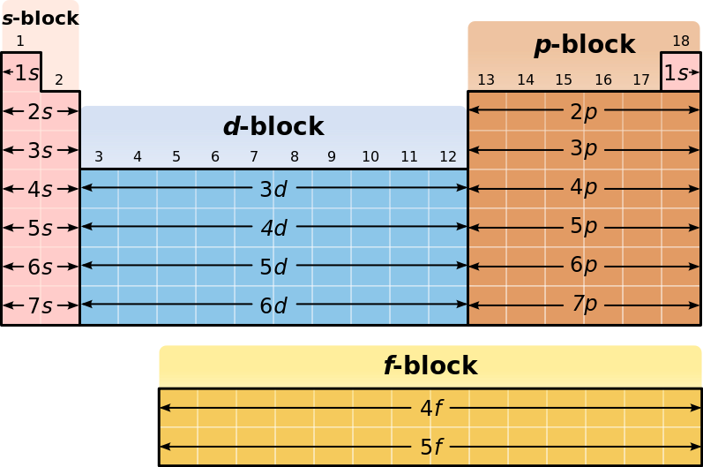
Blocks on the Periodic Table

Slide 17
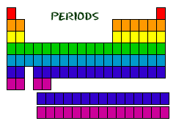
Elements of the same period have the same number of electron shells

Slide 18
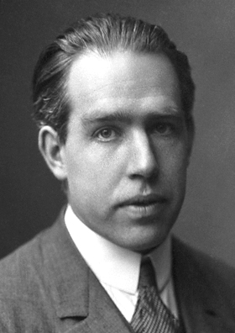
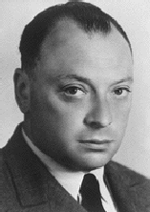
Aufbau Principle
Electrons will fill the orbitals with the lowest energy first
We Agree !!!
Wolfgang
Pauli
Niels Bohr

Slide 19
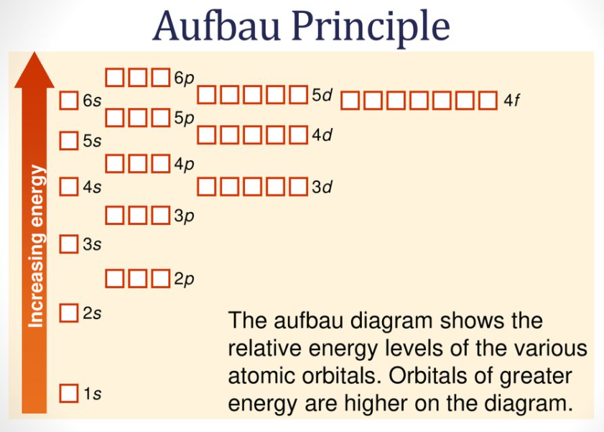

Slide 20
Aufbau and Madelung
How can you remember which sub-shell has the lowest energy?
The Madelung Rule

Slide 21
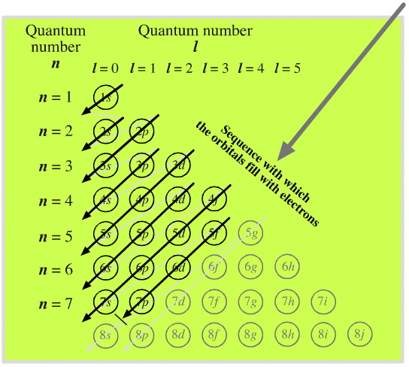
This is the order in which orbitals are arranged by increasing energy according to the Madelung rule.
Mr. Hardt tries to explain the pattern…
ℓ the azimuthal quantum number; the values ℓ = 0, 1, 2, 3 correspond to the s, p, d, and f labels, respectively

Slide 22
More Madelung
1 s → n = 1, l = 0; n+l = 1
2 s → n = 2, l = 0; n+l = 2
2 p → n = 2, l = 1; n+l = 3
3 s → n = 3, l = 0; n+l = 3
When 2 sub-shells have the same value for n+l, the one with the lower n value comes first
3 p → n = 3, l = 1; n+l = 4
4 s → n = 4, l = 0; n+l = 4
When 2 sub-shells have the same value for n+l, the one with the lower n value comes first
3 d → n = 3, l = 2; n+l = 5
4 p → n = 4, l = 1; n+l = 5
5 s → n = 5, l = 0; n+l = 5
When 2 or more sub-shells have the same value for n+l, the one with the lower n value comes first
etc...

Slide 23
Electron Configuration
When writing the electron configuration of an element, always write them in order from lowest energy to highest
Formating is as follows:
number of electrons found in sub-shell
Energy Level (shell)
1s²
This is the configuration for Helium
Sub-shell type

Slide 24
Steps for configuration
Count the number of electrons
(equal to the atomic number)
Start at the lowest energy level (1s)
Continue adding electrons until you run out
Example:
Element Cobalt
(27 electrons)
1s²
25
23
17
9
15
7
2s²
2p⁶
3s²
4s²
3p⁶
3d⁷
Noble Gas configuration:
[Ar]4s²3d⁷

Slide 25

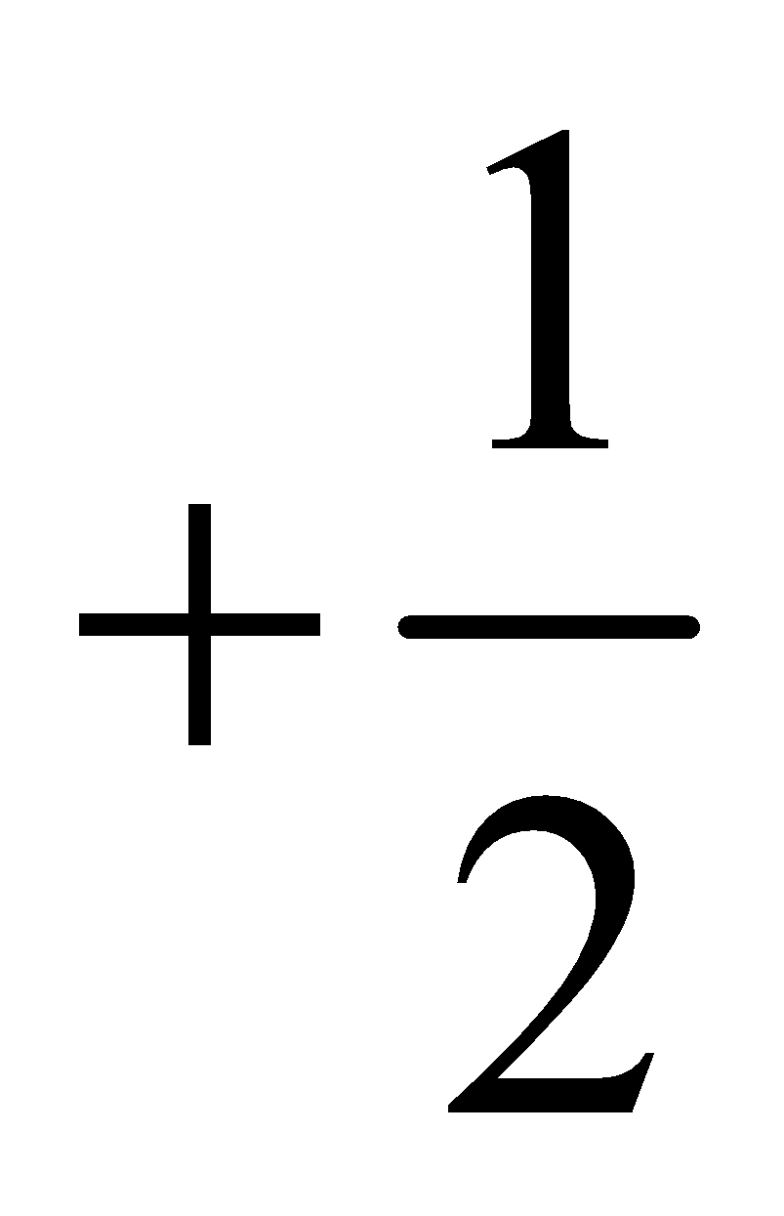
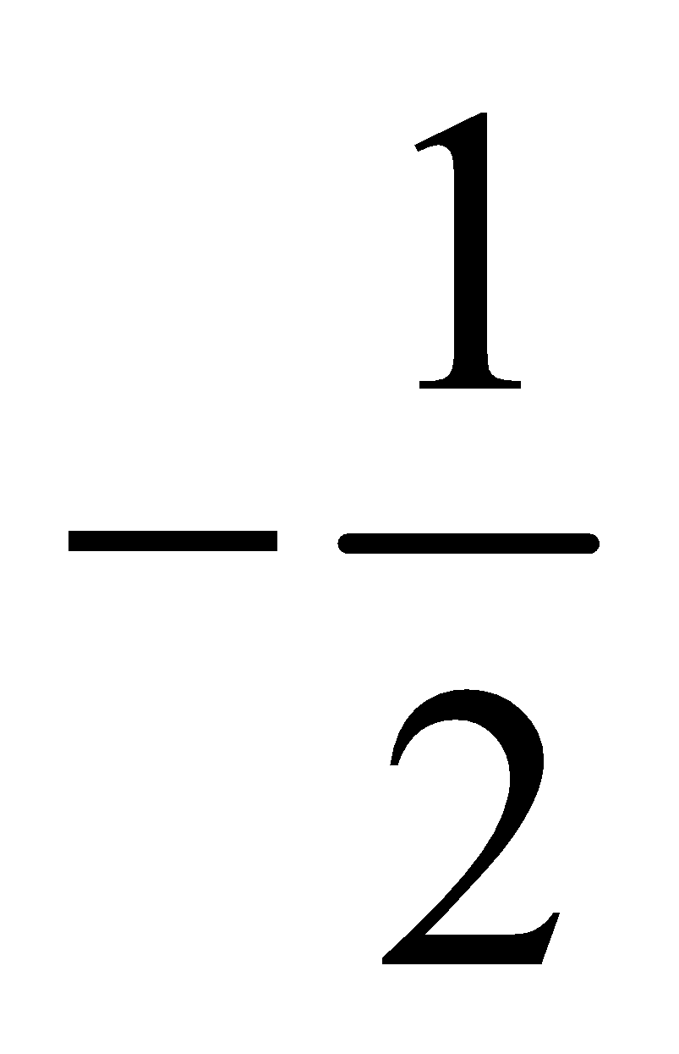
Electron Spin
Electron spin describes the behavior (direction of spin) of an electron within a magnetic field.
Possibilities for electron spin:

Slide 26
Pauli Exclusion Principle
Only two electrons may occupy the same orbital and they must have opposite spins
Wolfgang
Pauli

Slide 27
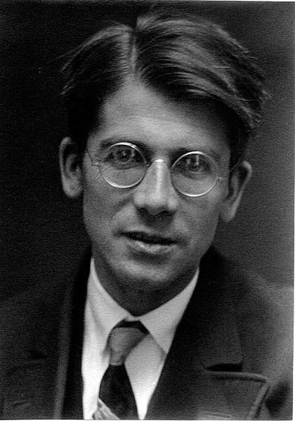
Hund’s Rule
If filling orbitals of the same energy then maximize the magnitude of the spin.
Friedrich Hund

Slide 28
Element | Configuration notation | Orbital notation | Noble gas notation
Lithium | 1s²2s¹ | ____ ____ ____ ____ ____ 1s 2s 2p | [He]2s¹
Beryllium | 1s²2s² | ____ ____ ____ ____ ____ 1s 2s 2p | [He]2s²
Boron | 1s²2s²2p¹ | ____ ____ ____ ____ ____ 1s 2s 2p | [He]2s²2p¹
Carbon | 1s²2s²2p² | ____ ____ ____ ____ ____ 1s 2s 2p | [He]2s²2p²
Nitrogen | 1s²2s²2p³ | ____ ____ ____ ____ ____ 1s 2s 2p | [He]2s²2p³
Oxygen | 1s²2s²2p⁴ | ____ ____ ____ ____ ____ 1s 2s 2p | [He]2s²2p⁴
Fluorine | 1s²2s²2p⁵ | ____ ____ ____ ____ ____ 1s 2s 2p | [He]2s²2p⁵
Neon | 1s²2s²2p⁶ | ____ ____ ____ ____ ____ 1s 2s 2p | [He]2s²2p⁶

Slide 29
Use the electron configuration to complete the spin diagram
1s²2s²2p⁶3s²3p⁶4s²3d⁷
____ ____ ____ ____ ____ ____ ____ ____ ____ ____ ____ ____ ____ ____ ____
1s 2s 2p 3s 3p 4s 3d

Slide 30
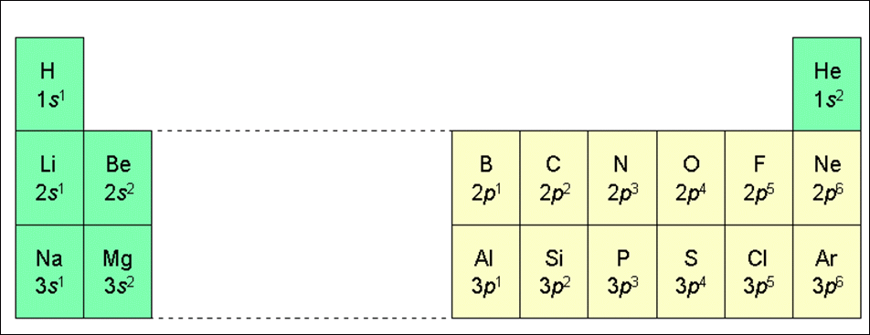
Electron configuration of the elements of the first three series
This pattern works for the first 23 elements

Slide 31
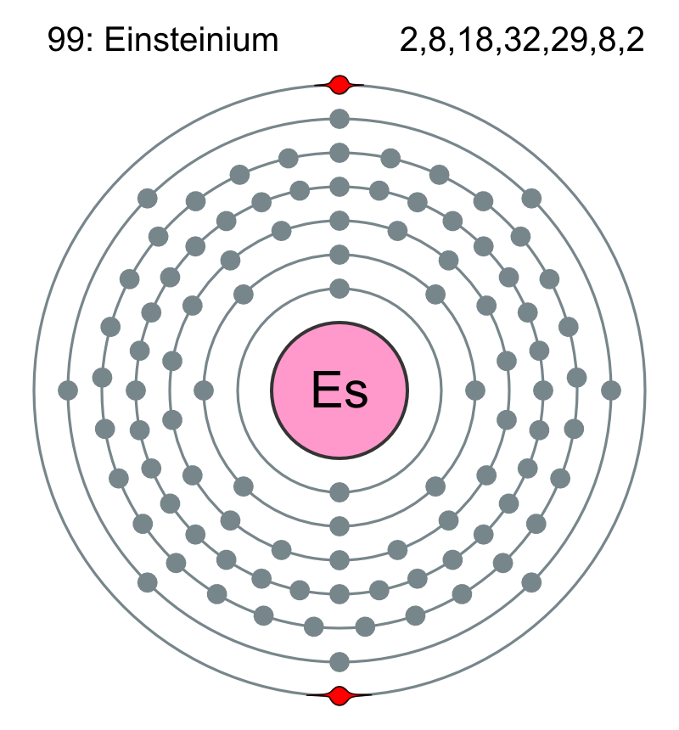
Valence
Electrons:
ELECTRONS AVAILABLE FOR BONDING

Slide 32
Definition
Valence electrons are electrons in the outermost shell (energy level).
They are the electrons available for bonding.

Slide 33
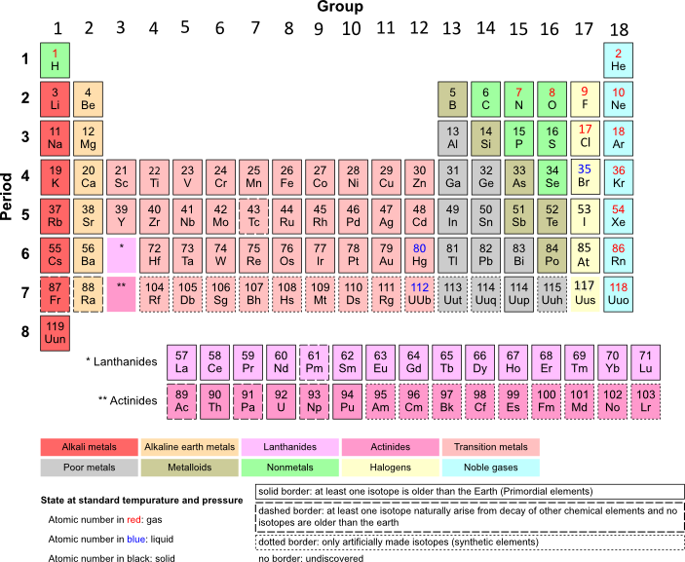
Group 1 (alkali metals) have 1 valence electron

Slide 34
Group 2 (alkaline earth metals) have 2 valence electrons

Slide 35
Group 13 elements have 3 valence electrons

Slide 36
Group 14 elements have 4 valence electrons

Slide 37
Group 15 elements have 5 valence electrons

Slide 38
Group 16 elements have 6 valence electrons

Slide 39
Group 17 (halogens) have 7 valence electrons

Slide 40
Group 18 (Noble gases) have 8 valence electrons, except helium, which has only 2

Slide 41
The electron configuration for transition metals predicted by the simple Aufbau principle and Madelung's rule has serious conflicts with experimental observations for transition metal centers under most ambient conditions. Under most conditions all of the valence electrons of a transition metal center are located in d orbitals while the standard model of electron configuration would predict some of them to be in the pertinent s orbital.- wikipedia

Slide 42
Lanthanides and actinides
(“f” block) have ??? valence electrons

Slide 43
In Practice
Valence electrons are the electrons in the s and p sub-shells of the outermost shell only.
This is a simplified model and does not fit all observed atomic behavior, but will work for our purposes
Elements in the same group have the same number of valence electrons and thus have similar chemical properties

Slide 44
Dot Notations
An atom’s valence electrons can be represented by Lewis dot notations.
1 valence e⁻ X | 2 valence e⁻ X | 3 valence e⁻ X | 4 valence e⁻ X
5 valence e⁻ X | 6 valence e⁻ X | 7 valence e⁻ X | 8 valence e⁻ X

Slide 45
Dot Notations – Period 2
Lewis dot notations for the valence electrons of the elements of Period 2.
lithium Li | beryllium Be | boron B | carbon C
nitrogen N | oxygen O | fluorine F | neon Ne

Slide 46

The ELECTRON:
Wave – Particle Duality
“No familiar conceptions can be woven around the electron. Something unknown is doing we don’t know what.”
-Sir Arthur Eddington
The Nature of the Physical World (1934)

Slide 47
The Dilemma of the Atom
Electrons outside the nucleus are attracted to the protons in the nucleus
Charged particles moving in curved paths lose energy
What keeps the atom from collapsing?

Slide 48
Quantum Mechanical
Model of the Atom
Mathematical laws can identify the regions outside of the nucleus where electrons are most likely to be found.
These laws are beyond the scope of this class…
Sorry, we will not be solving the Schrödinger Equation today

Slide 49


Slide 50
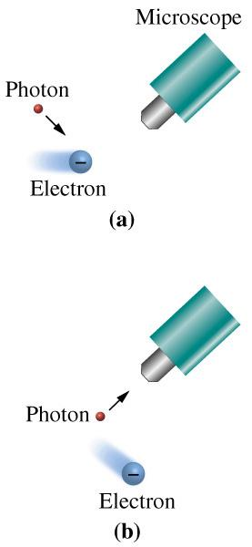
Heisenberg
Heisenberg Uncertainty Principle
  Can not know exactly the position and the velocity of a particle at the same time.
  The act of measuring will change one or the other.

Slide 51
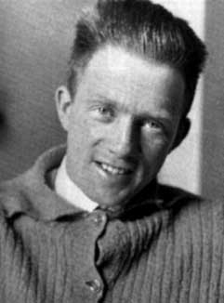
Heisenberg Uncertainty Principle
“One cannot simultaneously determine both the position and momentum of an electron.”
You can find out where the electron is, but not where it is going.
OR…
You can find out where the electron is going, but not where it is!
Werner
Heisenberg

Slide 52
Particle or Wave?
Light is most commonly treated as a wave, but there are times when it behaves more like a particle (photon)
Similarly, electrons (e⁻) also exist in this dual state where they exhibit characteristics of both. This duality explains why classic Newtonian physics do not work at the quantum level.

Slide 53
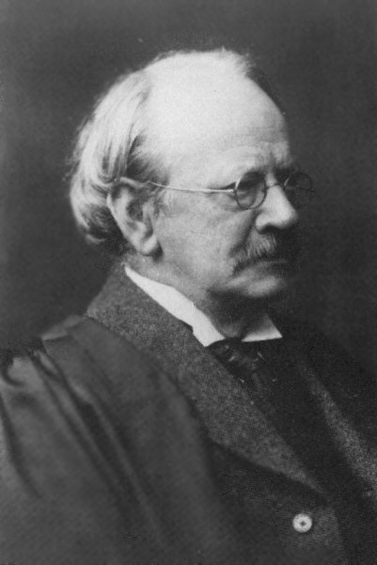
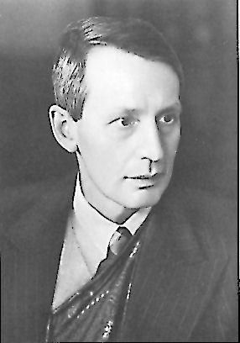
Wave-Particle Duality
JJ Thomson won the Nobel prize for describing the electron as a particle.
His son, George Thomson won the Nobel prize for describing the wave-like nature of the electron.
The electron is a particle!
The electron is an energy wave!

Slide 54
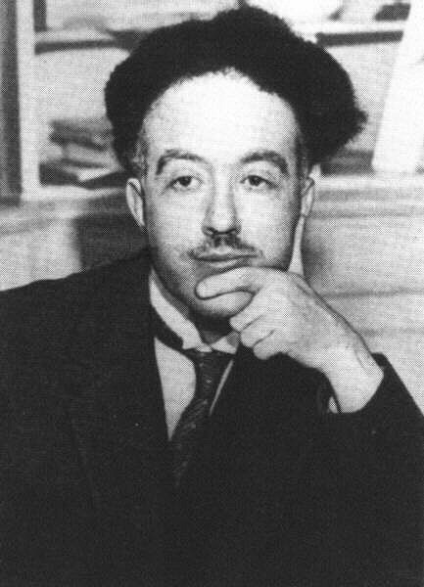
The Wave-like Electron
If light waves behaves as particles, then will particles behave like waves?
Since the electron propagates through space as an energy wave. To understand the atom, one must understand the behavior of electromagnetic waves.
Louis deBroglie

Slide 55
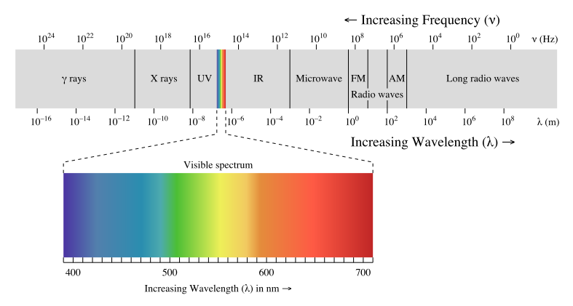
So we will study
Light and other EM radiation

Slide 56
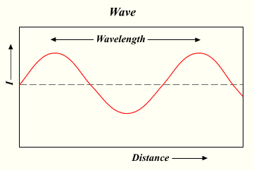
Electromagnetic radiation propagates through space as a wave moving at the speed of light.
A = amplitude
c = νλ
c = speed of light, a constant (3.00 x 10⁸ m/s)
ν = frequency, in units of hertz (nu) (Hz, sec⁻¹)
λ = wavelength, in meters (Lambda)
Note the inverse relation between ν and λ

Slide 57
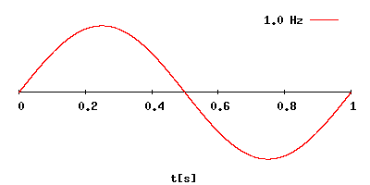
Increasing frequency
Decreasing wavelength
c = νλ
c = 3.00 x 10⁸ m/s
ν = frequency in hertz (Cycles / sec)
λ = wavelength in meters
Note the inverse relation between ν and λ

Slide 58
The energy (E ) of electromagnetic radiation is directly proportional to the frequency (ν) of the radiation.
E = hν
E = Energy, in units of Joules (kg·m²/s²)
h = Planck’s constant (6.626 x 10⁻³⁴ J·s)
ν = frequency, in units of hertz (Hz, sec⁻¹)
Note the direct relation between ν and E

Slide 59
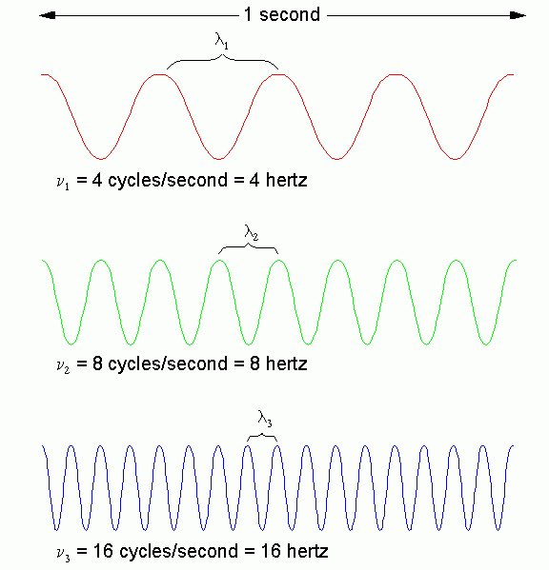
What it means
Long
Wavelength
=
Low Frequency
=
Low ENERGY
Short
Wavelength
=
High Frequency
=
High ENERGY

Slide 60
One way of Answering the Dilemma of the Atom
Treat electrons as waves
As the electron moves toward the nucleus, the wavelength shortens
Shorter wavelength = higher energy
Higher energy = greater distance from the nucleus

Slide 61
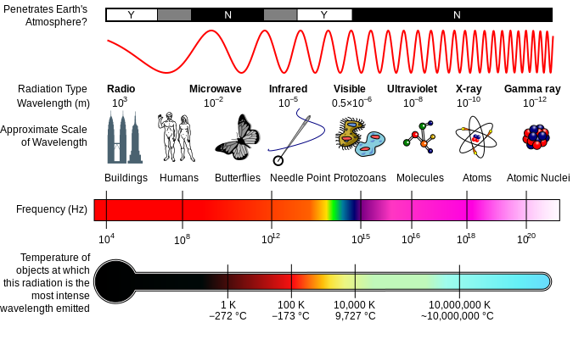
The Electromagnetic Spectrum

Slide 62
Mechanics
Classical Mechanics:
  Describes the motion of macroscopic objects
  Projectiles, parts of machinery, astronomical objects, such as spacecraft, planets, stars, and galaxies.
  Copernicus, Newton, Einstein
Quantum Mechanics:
  Reconciles the macroscopic laws of physics with the atomic nature of matter
  Handles the wave-particle duality of atoms and molecules.
  Schrödinger, Heisenberg, Pauli

Slide 63
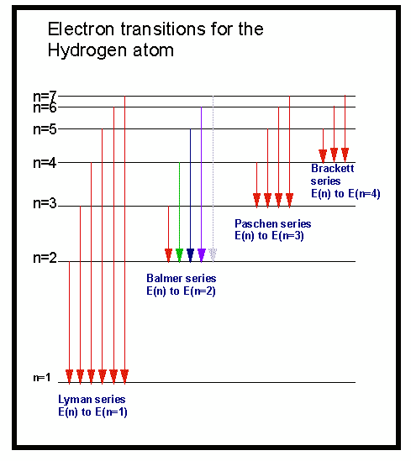
Electron transitions involve jumps of definite amounts of energy.
Definite amounts of energy are quanta.
Quanta of light are photons.

Slide 64
Electron transitions involve jumps of definite amounts of energy.
This produces bands
of light with definite wavelengths.
Lyman: Ultraviolet
Balmer: Visible
Paschen: Infrared
The lowest possible energy is the ground state

Slide 65
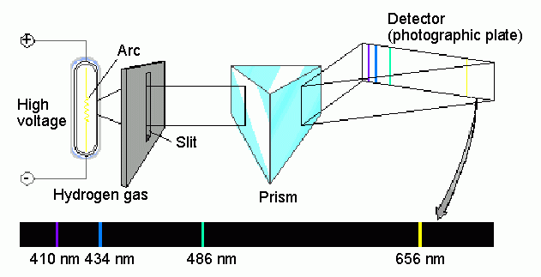
Spectroscopic analysis of the emission spectrum of Hydrogen…
…produces a “bright line” spectrum

Slide 66





Flame Tests
Many elements give off characteristic light which can be used to help identify them.
strontium
sodium
lithium
potassium
copper

Slide 67



The Chemistry of Fireworks
How Do Fireworks Work?

Slide 68
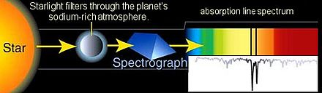
Absorption Spectra Exist Too
An example of applying Absorption spectroscopy is the first direct detection and chemical analysis of the atmosphere of a planet outside our solar system in 2001. Sodium filters the alien star light of HD 209458 as the hot Jupiter-like planet passes in front. The process and absorption spectrum are illustrated above.
Image Credit: A. Feild, STScI and NASA website.

Slide 69
Sources
http://en.wikipedia.org/wiki/D_electron_count
ScienceGeek.net http://www.sciencegeek.net/index.html

